Slide 1

Kotter’s Change Model
Change Superhero Toolkit Resource

Slide 2
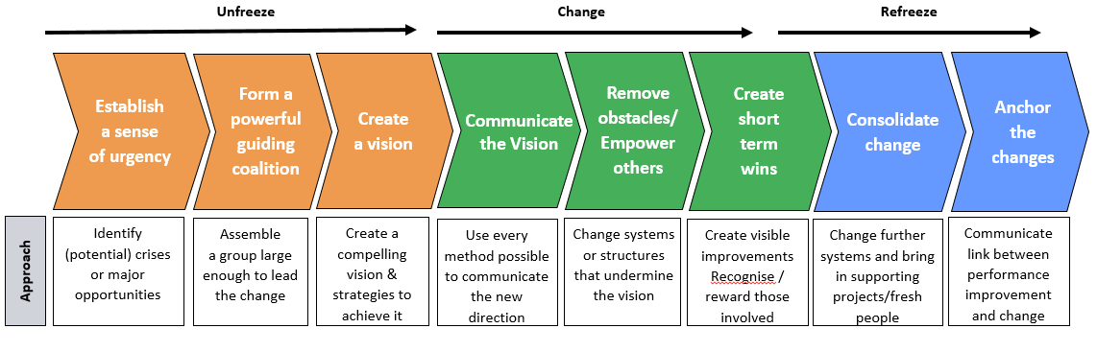

Kotter’s Change Model
“Our Iceberg is melting” – John Kotter

Slide 3
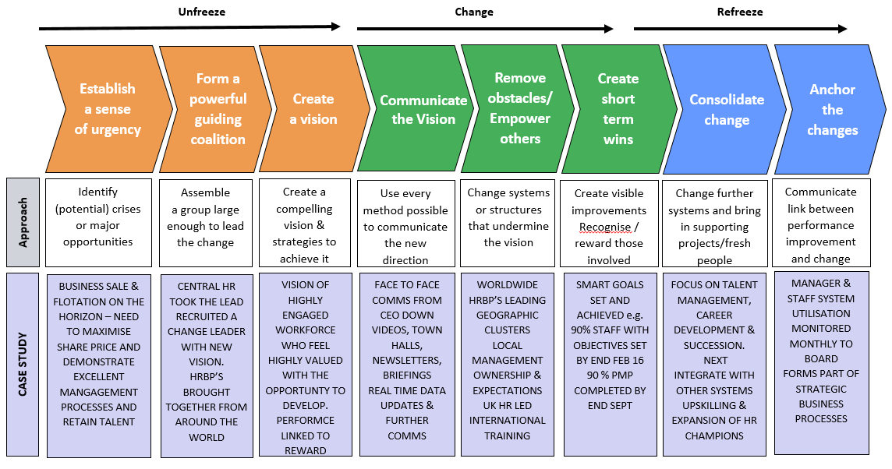
Case Study – Pharmaceutical, 5000 International Staff

Slide 4
How we can use the Kotter Model to be change agents?
Unfreeze
Change
Refreeze
Establish
a sense
of urgency
Form a powerful guiding coalition
Create
a vision
Remove obstacles/Empower others
Create
short term wins
Consolidate change
Anchor the changes
Communicate
the Vision
Identify (potential) crises or major opportunities
Assemble
a group large enough to lead the change
Create a compelling vision & strategies to achieve it
Use every method possible to communicate the new direction
Change systems or structures that undermine
the vision
Create visible improvements
Recognise/ reward those involved
Change further systems and bring in supporting projects/fresh people
Communicate link between performance improvement and change
Approach
Ensure clear start and end time for change with clear sponsorship to support urgency. Understand WHY Change
Make sure the right people are included – consider personal attributes, possible resistors, seniority & availability
Vision needs to be exciting & relevant to staff. It needs thinking through in detail – how to overcome issues?
Must have a senior & convincing sponsor. Ensure a variety of approaches & styles with time for people to ask questions
Ensure that natural reactions to change are accommodated. Keep momentum and refocus people positively on the future
Look for little wins and positives and SHOUT. Get senior and visible recognition for change leaders. Have a quiet word with laggards
Don’t stop – set ongoing milestones & next steps to embed change. Bring in fresh blood, choose Implementers & Completer Finishers now
Implement monitoring & checks for some time after change has ended. Ensure sponsors communicate value of new way
Role of HR Change Agent

Slide 5


